Slide 1
Welcome to the
2020 VIRTUAL
GENDER & SEXUALITY ALLIANCE (GSA) SUMMIT

Slide 2
How to Host A Virtual GSA Meeting
About GLSEN
Recap on Logistics
Advertising and Invitations
Meetings
We Have People, Now What?
Keep Up The Momentum
Q&A

Slide 3
About GLSEN
Championing LGBTQ issues in K-12 education since 1990
GLSEN is the leading national education organization focused on ensuring safe schools for all students, regardless of sexual orientation or gender identity/expression.
All students deserve a safe and supportive learning environment that is free of bias-based behavior.
Addressing LGBTQ bias in schools makes schools safer for all students regardless of their sexual orientation, gender identity or gender expression.

Slide 4
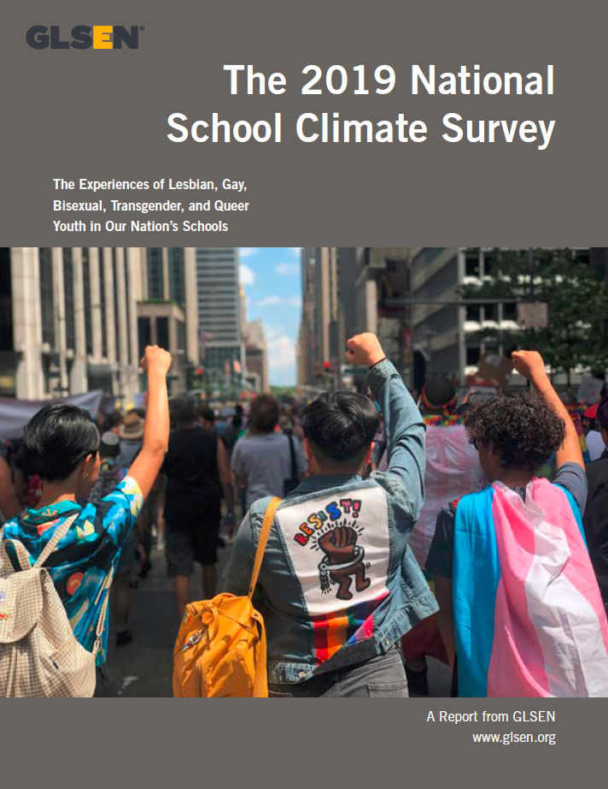
About GLSEN
- Original Research
- Educational Resources & Training
- Student Leadership & Action
- Policy Advocacy
- 41 Local Chapters

Slide 5
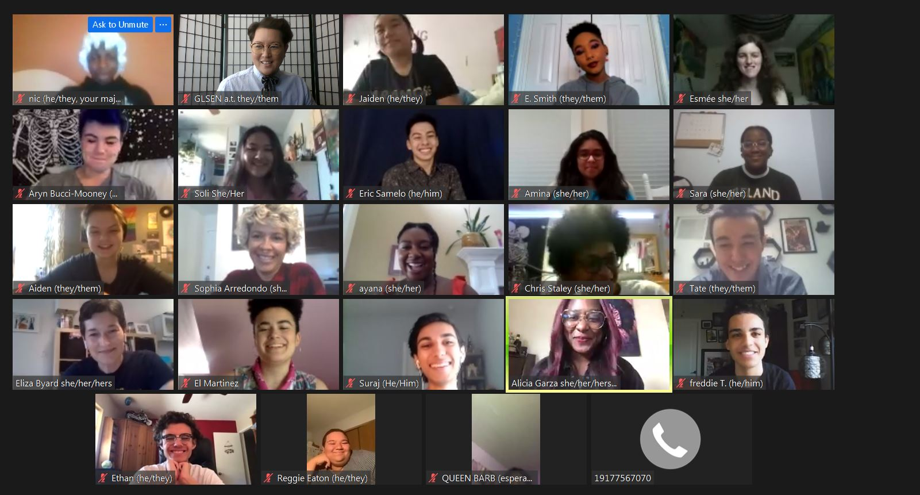
Recap on Logistics
GSA status
School policy
Register with GLSEN!
Find an online meetup platform that works for you and your GSA
Find a date and time that works best for the majority of the students.
Accessibility
Safety

Slide 6
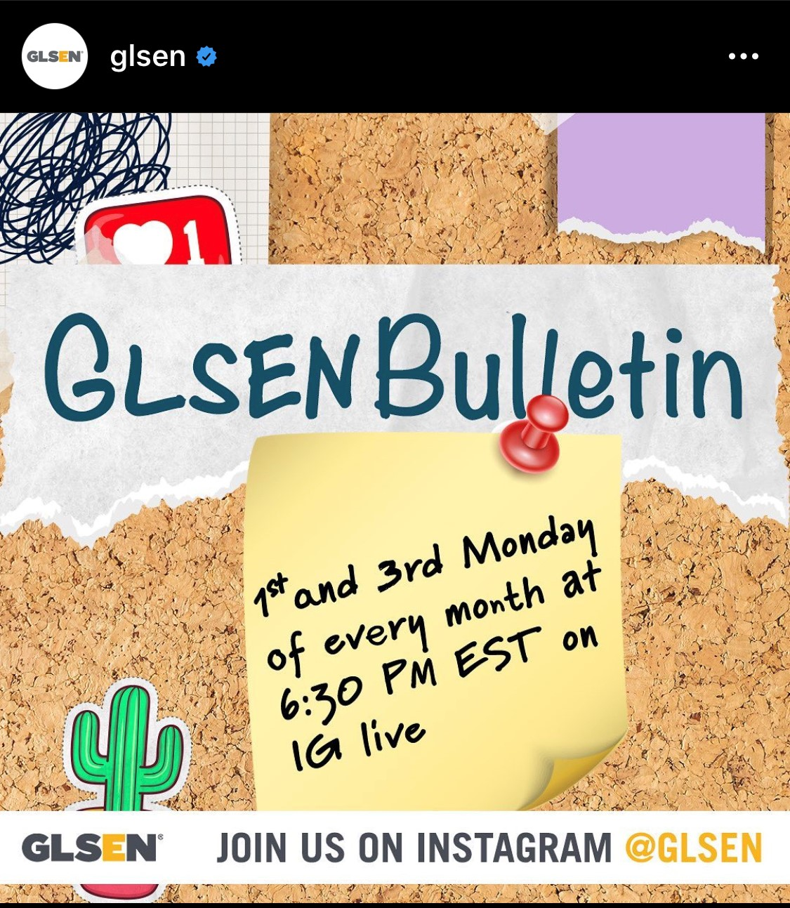
Advertising and Invitations
Flyers
Daily Announcements
School website or social sites
Invitations (Discord chat, IG Chats,
Share with other educators
Share with Community Orgs

Slide 7
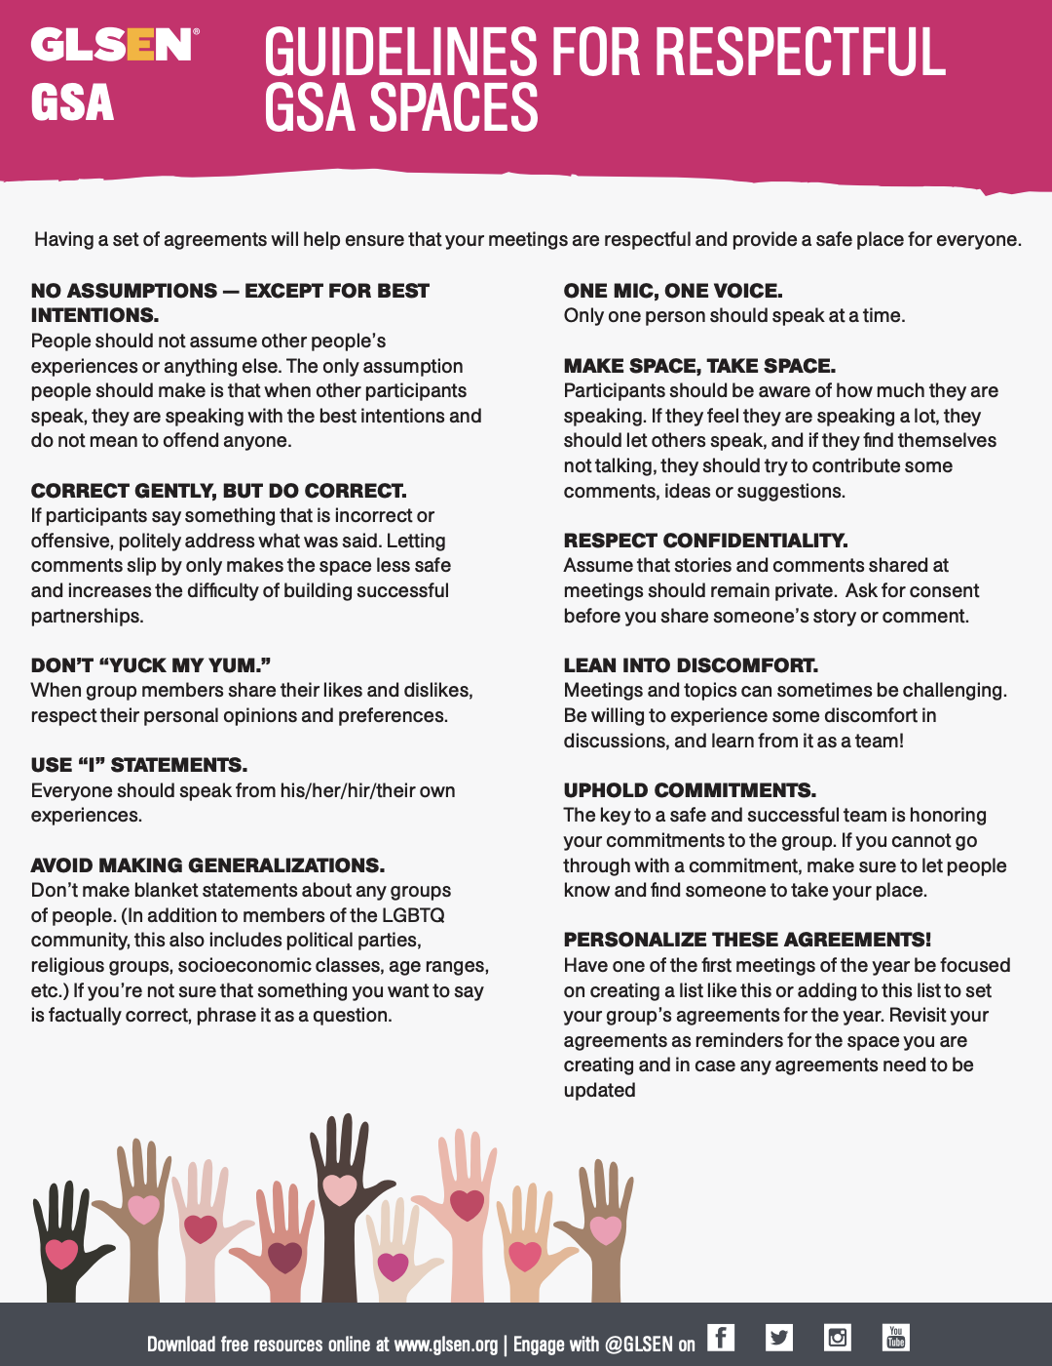
Meetings
Space agreements
Create an agenda
What is the purpose of the meeting
Facilitator, note taker, stack keeper, Greeter
Delegate
Check in/out Question + Popcorn
Explore topics and assess the needs of the club

Slide 8
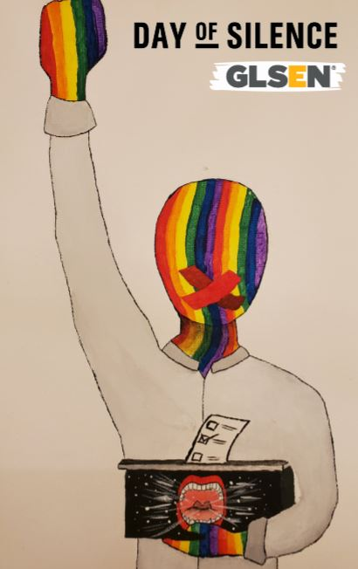
We Have People, Now What?
Fun and Creative Activities
Charades, pictionary, Rock Paper Scissors, group study time, Zines, Playlists, Cosplay, crafting, houseparty, discussion groups (racial justice, gender justice and disability justice etc.)
Events
Meet and Greets, Trivia Night, Movie Night, Prom, Graduation, Leadership trainings, identity trainings

Slide 9
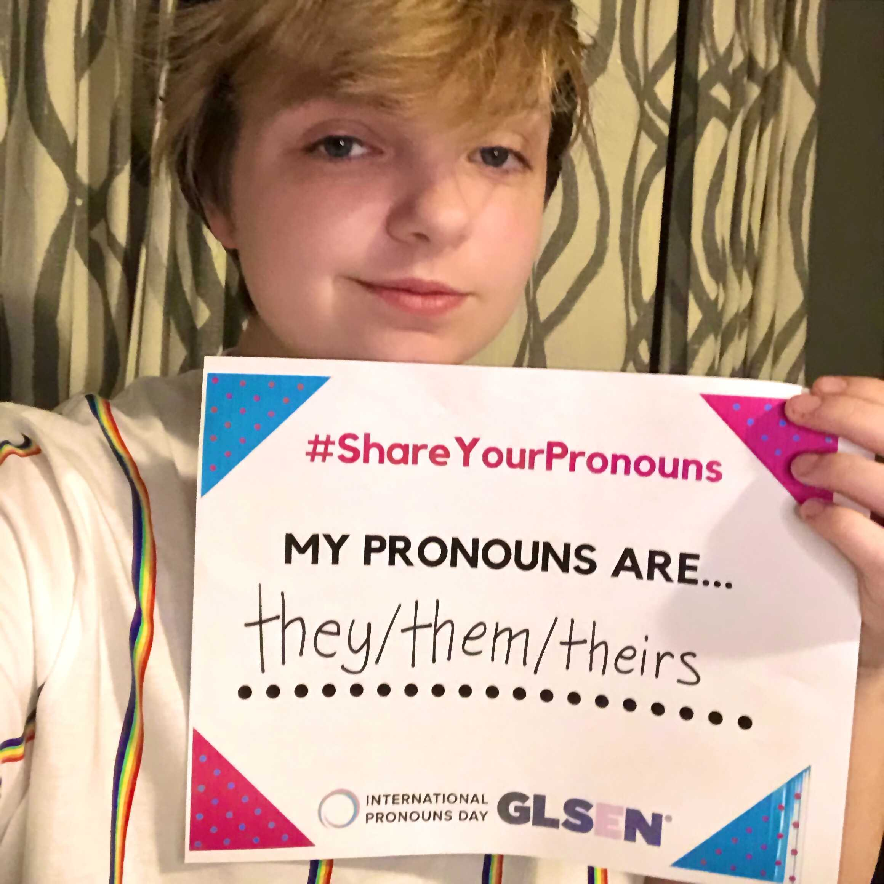
We Have People, Now What? Con’t
Days of Action
Solidarity Week Oct 5-9
No Name Calling Week Jan 18-22
Day of Silence April 23
Awareness Days
National Coming Out Day Oct 11
LGBTQ+ History Month Oct
International Pronoun Day Oct 21

Slide 10
Keep Up The Momentum
Follow Up
Invitations
1:1 Check ins
Reevaluate goals mid semester
Join the National GSA Leadership Coalition!
Stay hydrated!

Slide 11
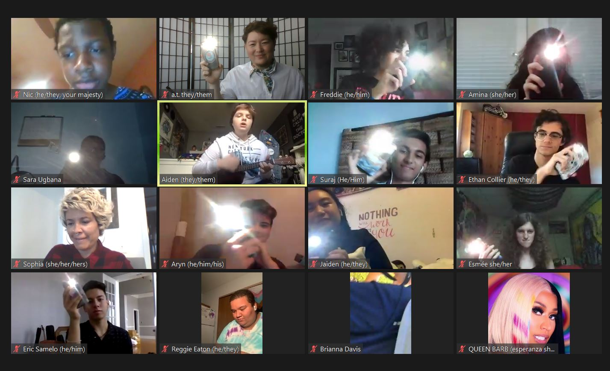
Questions

Slide 12
Thank you for joining us today!
We look forward to having you join the remainder of our sessions during the GSA Summit!
Please watch for an email from NEA edjustice following the summit for a link to the recorded sessions. All sessions will be posted on the GLSEN website.

Slide 13
FOLLOW the Conversation!
#GSA2020
#EdJustice

Slide 14
Resources
NEA edjustice: https://neaedjustice.org/
GLSEN: https://www.glsen.org/

