Slide 1
Welcome to the
2020 VIRTUAL
GENDER & SEXUALITY ALLIANCE (GSA) SUMMIT

Slide 2
How to Host A Virtual GSA Meeting
About GLSEN
Jumpstart Your GSA
Logistics
Things to Consider
Organize the Meeting
GSA Collaboratives
Building YOUR Team

Slide 3
About GLSEN
Championing LGBTQ issues in K-12 education since 1990
GLSEN is the leading national education organization focused on ensuring safe schools for all students, regardless of sexual orientation or gender identity/expression.
All students deserve a safe and supportive learning environment that is free of bias-based behavior.
Addressing LGBTQ bias in schools makes schools safer for all students regardless of their sexual orientation, gender identity or gender expression.

Slide 4
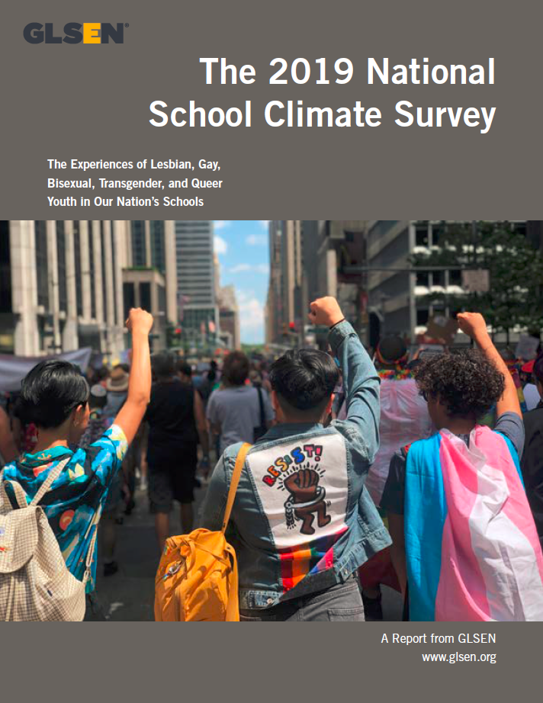

About GLSEN
- Original Research
- Educational Resources & Training
- Student Leadership & Action
- Policy Advocacy
- 41 Local Chapters

Slide 5
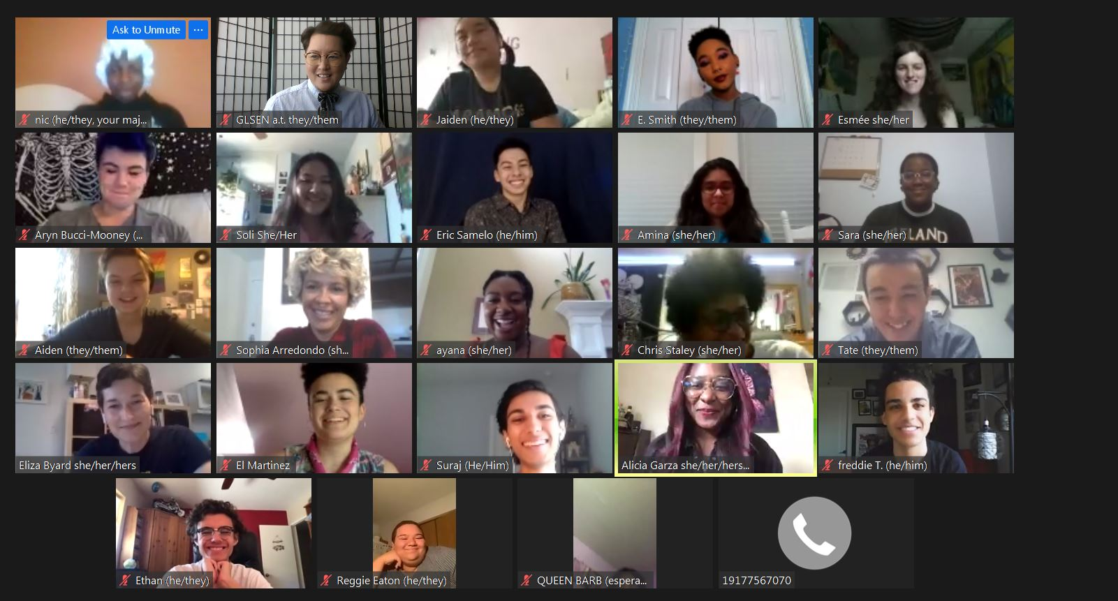
Jumpstart Your GSA
Why are GSAs important?
Core connect
GSA status
  School policy
  Register with GLSEN!
Your support
Assess your capacity

Slide 6





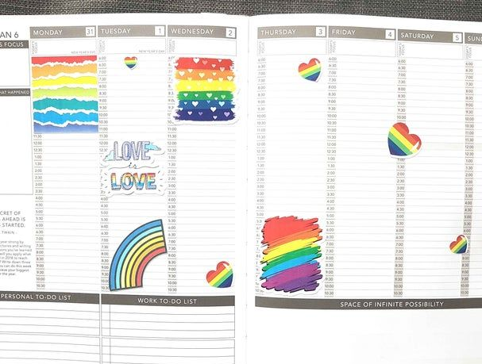

Logistics
Find an online meetup platform that works for you and your GSA
Find a date and time that works best for the majority of the students.

Slide 7
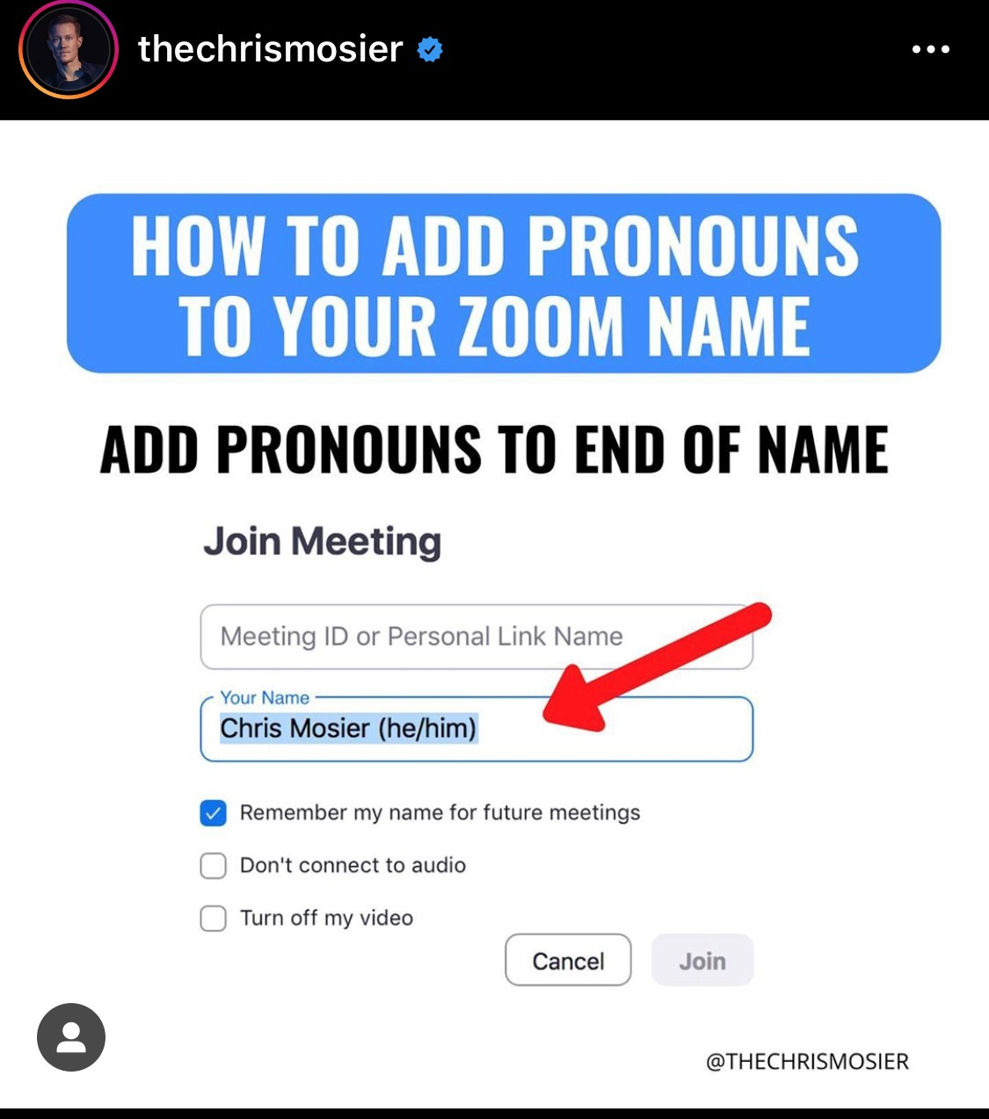
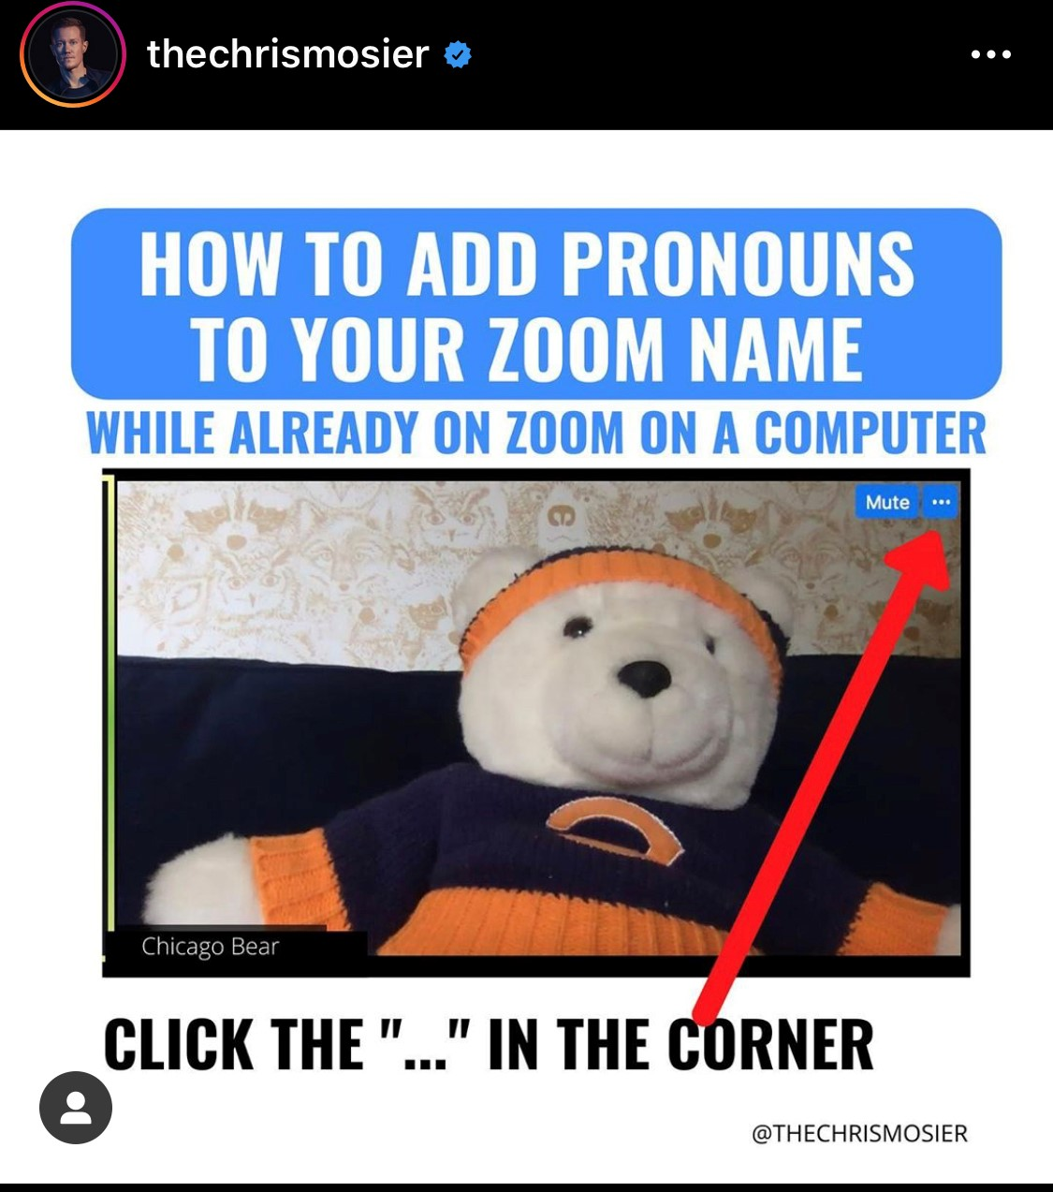
Things to Consider
Accessibility
Safety
Transgender including nonbinary students support
High attendance does not = success!

Slide 8
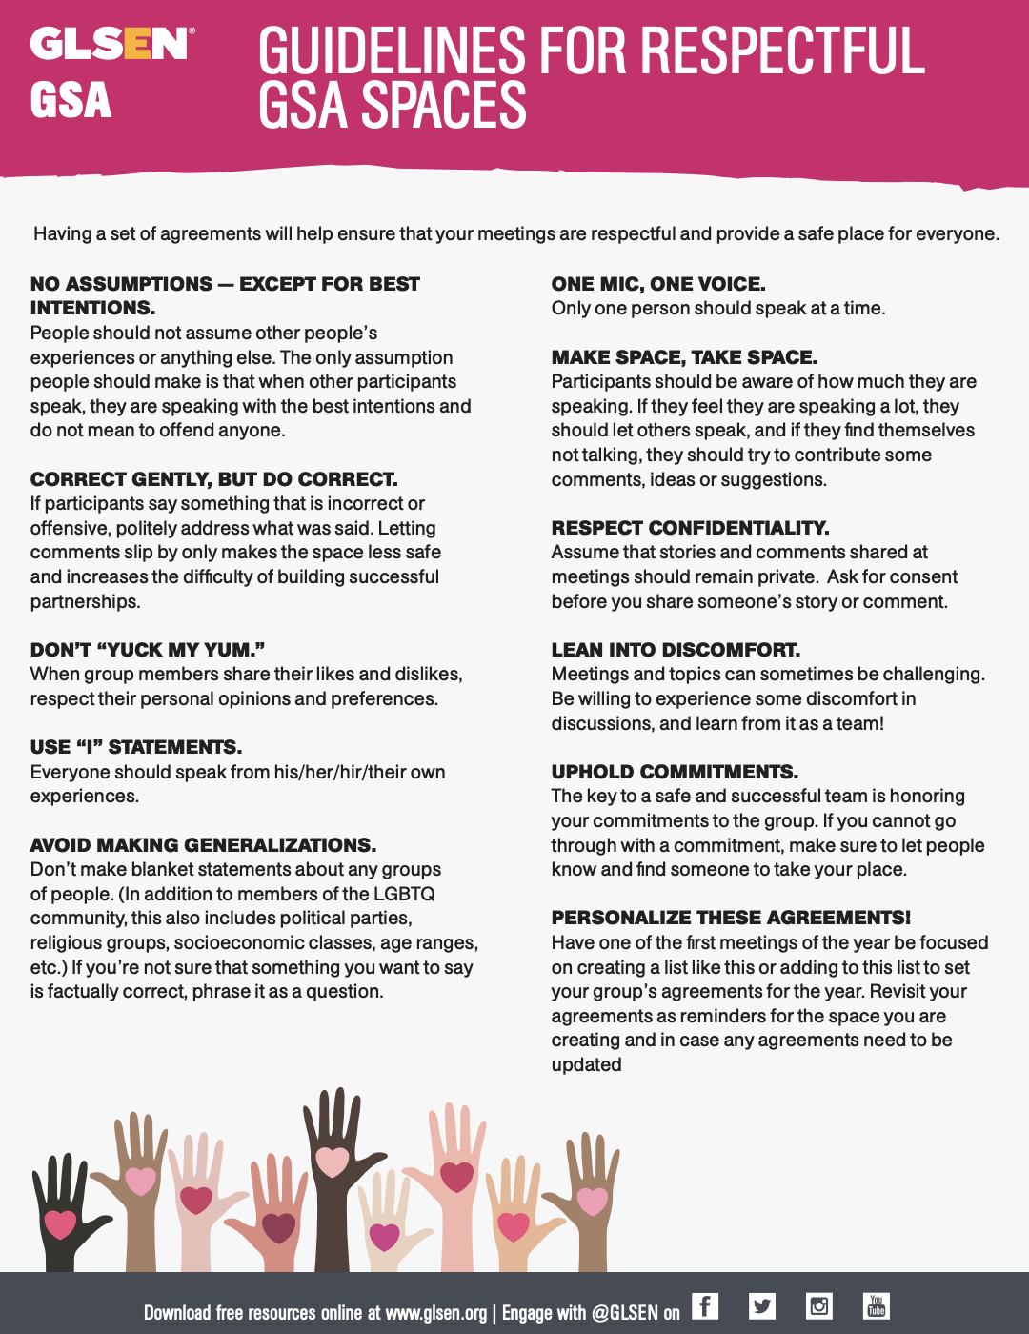
Organize the Meeting
Space Agreements
Assess the Needs of the Students
  WIFI access
  Social or advocacy
  Mutual Aid
Create an Agenda
Explore Topics
Create Goals
Delegation Station
GLSEN Days of Action

Slide 9
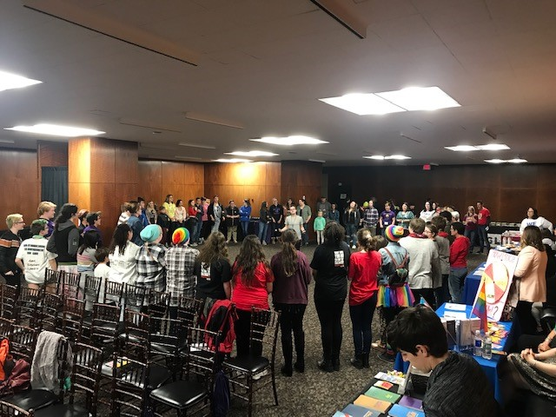
GSA Collaboratives
Purpose
Benefits
Networking
Teacher Support

Slide 10

Building Your Team
Connect with Other Teachers
Who’s Got Your Back?
Who Could Have Your Back?
Assess your capacity
Be strategic with your resources
Recharge
Stay hydrated!

Slide 11
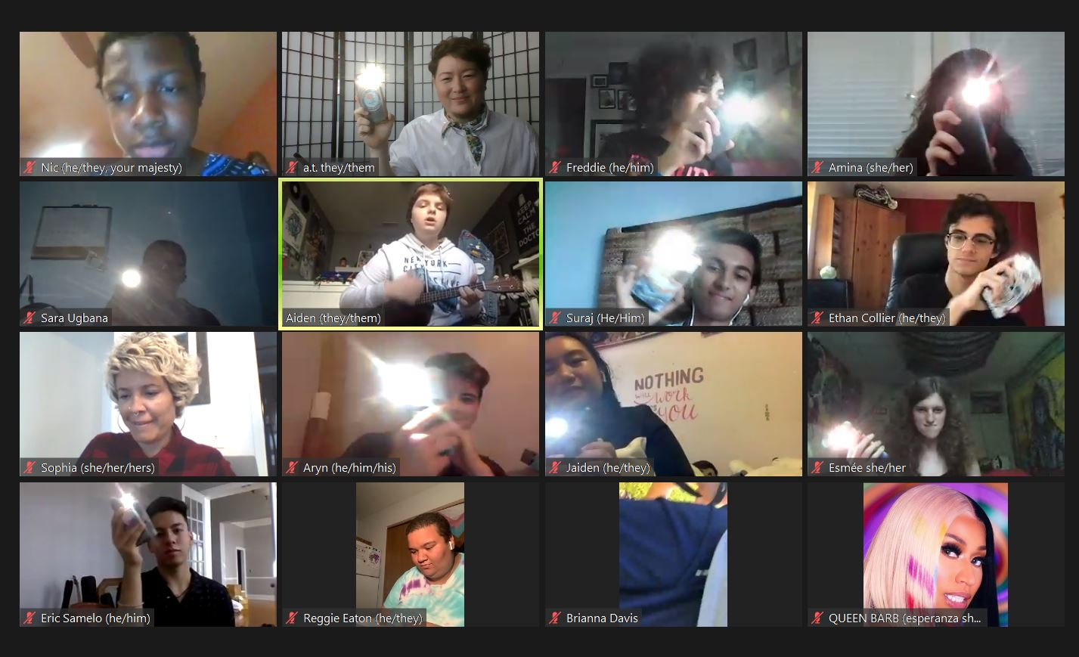
Questions

Slide 12
Thank you for joining us today!
We look forward to having you join the remainder of our sessions during the GSA Summit!
Please watch for an email from NEA edjustice following the summit for a link to the recorded sessions. All sessions will be posted on the GLSEN website.

Slide 13



FOLLOW the Conversation!
#GSA2020
#EdJustice

Slide 14
Resources
NEA edjustice: https://neaedjustice.org/
GLSEN: https://www.glsen.org/

